Slide 1
Tech-Driven Solutions for Undertrial Prisoners in India
PIP4004 Capstone Project
Review-2
Batch Number: CSE-G26
Roll Number | Student Name
20211CSE0114 | REDDY MASY TEJA
20211CSE0112 | KASTURI DEEPAK
20211CSE0125 | D PHANI BALA JASWANTH
20211CSE0122 | YAGANTI PRAVEN
Under the Supervision of,
Ms.. ROHINI
Assistant Professor
School of Computer Science and Engineering
Presidency University
Name of the Program: Computer Science and Engineering(CSE)
Name of the HoD: Dr. Asif Mohammed
Name of the Program Project Coordinator: Mr. Amarnath J L
Name of the School Project Coordinators:Mr. Md Ziaur Rahman

Slide 2
INTRODUCTION
Because of India's sluggish legal system, undertrial inmates—those awaiting trial—frequently endure protracted incarceration. This problem has resulted in severe human rights violations and overcrowding in jails. Promising approaches to overcoming these obstacles and guaranteeing more effective justice are provided by tech-driven solutions. In order to ensure quicker responses, artificial intelligence (AI) may be used to evaluate case backlogs and assist in prioritizing cases according to urgency or severity. Inmates can participate in remote court sessions using digital technologies, eliminating the need for inmate transports and reducing travel expenses and delays. Blockchain technology can offer clear, unchangeable case records, lowering the possibility of systemic corruption or manipulation. By using data analytics, the judicial system can better allocate resources, manage court schedules, and spot patterns in case delays. The problem of inadequate legal representation can be addressed via virtual legal aid programs that pair undertrials with pro bono attorneys, particularly in underserved or rural locations. The planning and general effectiveness of the legal system might be enhanced by machine learning algorithms that forecast trial dates and case completion periods. By improving collaboration between law enforcement, courts, and other legal entities, these technologies can also lower human error. Such methods can assist alleviate prison overcrowding, provide prompt justice, and protect the rights of inmates awaiting trial by removing systemic bottlenecks.

Slide 3
Problem Statement :
To develop technology-driven solutions that address the challenges faced by undertrial prisoners in India, including legal aid, access to justice, and rehabilitation. Key features: 1. A mobile app that provides legal aid to undertrial prisoners, including legal representation, access to court proceedings, and legal resources. 2. A platform that connects undertrial prisoners with pro bono lawyers, legal clinics, and legal aid organizations including UTRCS for bail process. 3. A rehabilitation program that uses technology to provide education, vocational training, and mental health support to undertrial prisoners. 4. A dashboard that tracks and monitors the status and progress of undertrial prisoners, providing real-time information to lawyers, judges, and prison authorities. 5. A virtual platform that allows undertrial prisoners and the support-persons to access the awareness of rights and various provisions of UTPs and thereby improving access to justice. Deliverables: 1. A functional prototype of the technology-driven solution that addresses the challenges faced by undertrial prisoners in India. 2. A comprehensive business plan that outlines the feasibility, sustainability, and scalability of the proposed solution. 3. A pitch deck that effectively communicates the problem statement, solution, and impact of the proposed solution. Expected impact: 1. Increased access to legal aid and representation for undertrial prisoners, leading to a more equitable and fair criminal justice system in India. 2.Improved rehabilitation outcomes for undertrial prisoners, reducing recidivism rates and promoting social reintegration. 3. Increased transparency and accountability in the criminal justice system, reducing the number of undertrial prisoners languishing in jails. 4. Increased collaboration between legal and tech experts, leading to innovative and impactful solutions for social justice.

Slide 4
LITERATURE SURVEY
Sl.no | Paper Title | Authors | Proposed Model | Results | Drawbacks | Year
1 | AI-Based Case Management System for Undertrial Prisoners | Sharma R., Kumar P. | AI-powered system that tracks case progress and provides real-time updates on trial status. | Reduced case backlogs and improved case tracking accuracy. | Requires integration with court databases for real-time updates. | 2022
2 | Blockchain for Transparent Prisoner Records | Verma K., Das S. | Blockchain-based system for maintaining tamper-proof prisoner records and legal proceedings. | Enhanced transparency and security in case records. | High implementation cost and requires legal framework adaptation. | 2021
3 | IoT-Based Monitoring System for Undertrial Prisoners | Gupta A., Nair V. | IoT-enabled wearables to track prisoners’ movements and ensure compliance with bail conditions. | Improved prisoner tracking and reduced violations of bail terms. | Privacy concerns and risk of device malfunction. | 2023
4 | Machine Learning for Bail Prediction | Mehta P., Roy D. | ML algorithm analyzing previous court cases to predict bail eligibility for undertrial prisoners. | Faster bail recommendations and reduced judicial burden. | Requires large datasets for accurate predictions. | 2022
5 | Automated Legal Assistance Chatbot for Prisoners | Singh R., Bose T. | NLP-based chatbot to provide legal aid and guide prisoners on their rights. | Increased legal awareness among undertrial prisoners. | Limited understanding of complex legal queries. | 2023

Slide 5
OBJECTIVE OF PROJECT
1.Improve Interactions Between Attorneys and Undertrial Inmates
Offer a real-time chat feature to enable smooth communication.
Give attorneys the ability to exchange legal papers and update case status.
2. Boost Legal Proceedings' Transparency
Provide accurate case updates to inmates and their families.
Provide a centralized case management system to cut down on false information.
3.Automate Case Monitoring and Appointment Scheduling
Permit inmates to schedule consultations with attorneys.
Inform users of impending hearings, the status of their cases, and due dates.
4.Offer Legal Aid Driven by AI
Include an AI chatbot to help with legal inquiries.
Automate routine questions to lighten the stress on judges and attorneys.
5.Assure Inclusivity and Accessibility
Provide multilingual support for a wide range of users.
Create an intuitive user interface for people who don't know much about technology.

Slide 6
SCOPE
1.Integration with Government and Judicial Systems
Collaborate with the Indian judiciary and prison authorities to integrate the platform with official legal databases and case management systems.
Enable real-time updates on case status, hearing schedules, and bail applications.
2.AI-Powered Legal Assistance
Use AI for predictive analytics to identify prisoners eligible for early release or alternative sentencing.
Develop AI-driven chatbots and virtual assistants to provide instant legal guidance to undertrial prisoners
3.Blockchain for Transparency
Implement blockchain-based record-keeping for court proceedings, bail applications, and prisoner status tracking to enhance transparency and reduce data tampering.
4.Expansion to Other Vulnerable Groups
Extend the platform’s services to other marginalized communities facing legal challenges, such as refugees, migrant workers, and juveniles.
5.Multilingual and Regional Expansion
Introduce multilingual support to cater to undertrial prisoners from different linguistic backgrounds.
Expand the platform beyond India to other countries facing similar issues in their criminal justice systems.
.

Slide 7
Existing method Drawback
Limited Focus on Prisoner Rights & Communication
The existing system primarily focuses on AI-driven security measures, such as monitoring inmate phone calls and analyzing CCTV footage. However, it does not address the communication barriers between undertrial prisoners, lawyers, and judicial authorities.
Lack of Transparency
AI-based surveillance systems monitor and analyze behavior, but they do not provide undertrial prisoners with direct access to case updates or legal resources. This can lead to misinformation and uncertainty about legal proceedings.
No Legal Assistance or Case Management Features
The current system does not facilitate real-time legal consultations, case tracking, or document sharing between lawyers and prisoners, which are essential for effective legal representation.
Focus on Crime Prevention Rather Than Legal Aid
While AI-driven security systems enhance prison surveillance, they do not contribute to ensuring fair trials, legal support, or rehabilitation opportunities for undertrial prisoners.
Lack of AI-Based Legal Support
No AI chatbot or automated system exists to assist prisoners with legal inquiries, which could otherwise help reduce the workload of lawyers and judicial officers

Slide 8
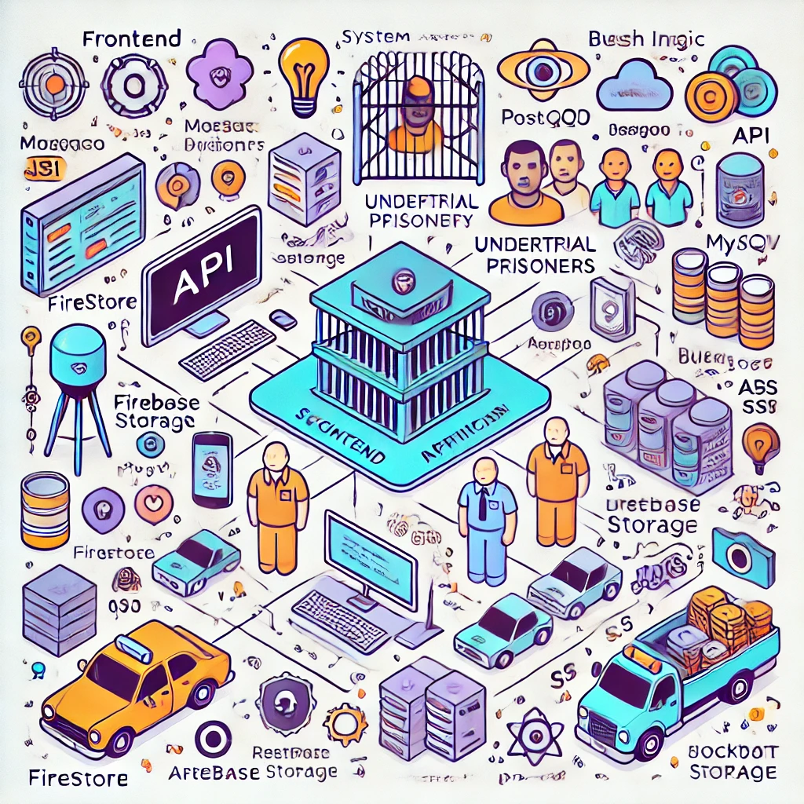
Architecture

Slide 9
Software Components
Frontend Development:
Technology: Flutter (Dart) / React Native
Purpose: Cross-platform mobile application development (Android & iOS)
Alternative: Native Android (Java/Kotlin) or iOS (Swift)
Backend Development:
Technology: Node.js (Express.js) / Django (Python) / Spring Boot (Java)
Purpose: Handles business logic, authentication, and API requests
Database Management System (DBMS):
Technology: Firebase Firestore / MySQL / PostgreSQL / MongoDB
Purpose: Stores user profiles, case details, chat logs, and appointment records
Authentication & Security:
Technology: Firebase Authentication / OAuth 2.0 / JWT (JSON Web Token)
Purpose: Secure user authentication and role-based access control
Real-Time Communication:
Technology: Firebase Realtime Database / WebSockets (Socket.io)
Purpose: Enables real-time messaging between lawyers and prisoners

Slide 10
Modules
System for Storing and Retrieving Documents
safe cloud-based storage for court records, legal documents, and case files.
Simple document sharing and retrieval for authorized users.
1.System for Notification and Reminders
Notifies of impending hearings, case developments, and the availability of attorneys.
sends out reminders for crucial legal deadlines and appointments.
2.Support for Multiple Languages and Accessibility
supports several languages in order to serve a wide range of users.
guarantees usability for users with varying degrees of technological expertise.
3.Protection of Privacy and Data Security
uses safe access control methods and encryption.
shields private and sensitive legal information from unwanted access.
4.Management of User Profiles and Customization
enables users to control their case history, preferences, and personal information.
Notification and communication choices can be changed.

Slide 11
Github Link
The Github link provided should have public access permission.
Github Link
https://github.com/deepak/Tech-Driven Solutions for Undertrial Prisoners in India

Slide 12
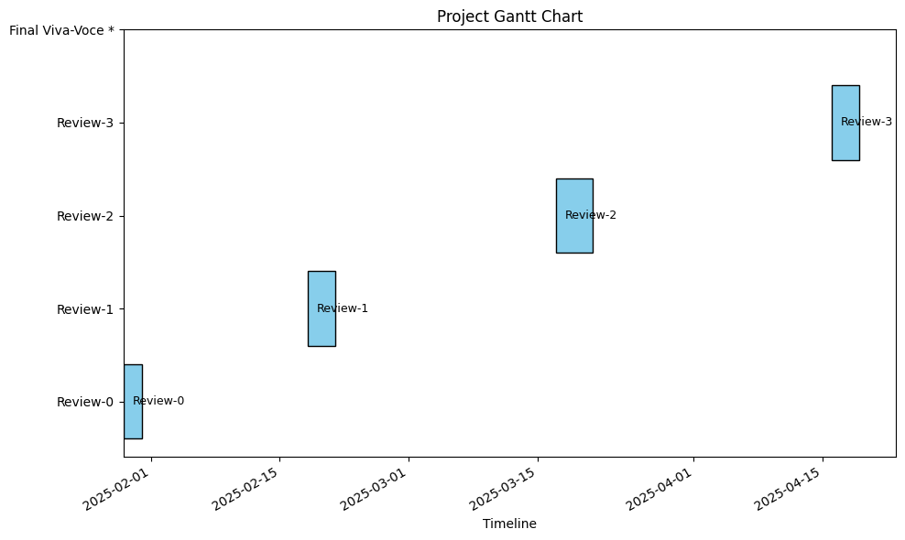
Timeline of the Project (Gantt Chart)

Slide 13
References (IEEE Paper format)
J. Qin, Y. Chen, W. Fu, Y. Kang, and M. Perc, ‘‘Neighborhood diversity promotes cooperation in social dilemmas,’’ IEEE Access, vol. 6, pp. 5003–5009, 2018
J. Reiman and P. Leighton, Rich Get Richer and the Poor Get Prison: Ideology, Class, and Criminal Justice. Evanston, IL, USA: Routledge, 2015.
Y. Li, J. Zhang, and M. Perc, ‘‘Effects of compassion on the evolution of cooperation in spatial social dilemmas,’’ Appl. Math. Comput., vol. 320, pp. 437–443, Mar. 2018. IJCRT2404142 International Journal of Creative Research Thoughts (IJCRT) www.ijcrt.org b264 www.ijcrt.org © 2024 IJCRT | Volume 12, Issue 4 April 2024 | ISSN: 2320-2882
C. Xia, S. Ding, C. Wang, J. Wang, and Z. Chen, ‘‘Risk analysis and enhancement of cooperation yielded by the individual reputation in the spatial public goods game,’’ IEEE Syst. J., vol. 11, no. 3, pp. 1516–1525, Sep. 2016.
Z. Rong, Z.-X. Wu, and G. Chen, ‘‘Coevolution of strategy-selection time scale and cooperation in spatial Prisoner’s dilemma game,’’ EPL (Europhys. Lett.), vol. 102, no. 6, p. 68005, 2013.

Slide 14


